Slide 1
Weekly Progress meeting
Geunhyeong Lee
1/08/2025

Slide 2
Tasks
Rotating beam dump analysis
Target spindle experiments
Compared to the Tracy’s results
3D Radiolysis analysis
Beam dump shape optimization
Analysis of previous experiments
Preparing for the following experiment
Conduct experiments

Slide 3
Tasks
Rotating beam dump analysis
Target spindle experiments
Compared to the Tracy’s results
3D Radiolysis analysis
Beam dump shape optimization
Current progress
Analysis of previous experiments
Preparing for the following experiment
Conduct experiments
Current progress

Slide 4
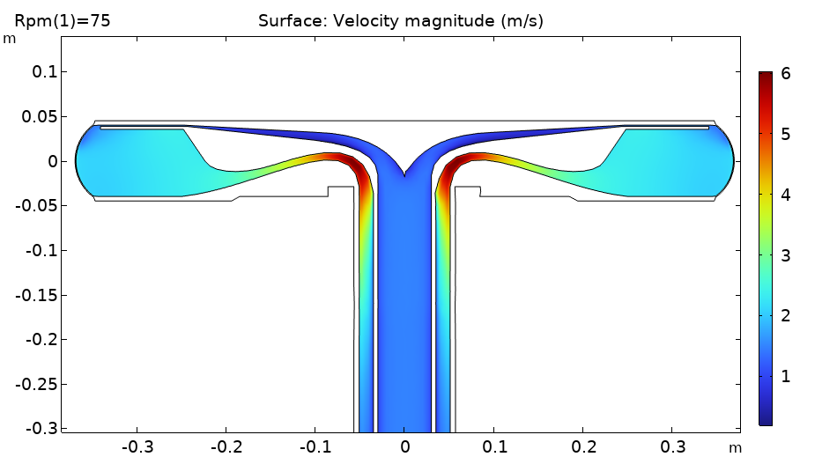
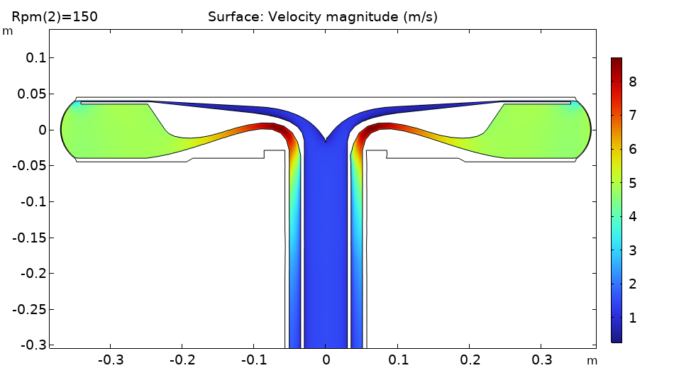
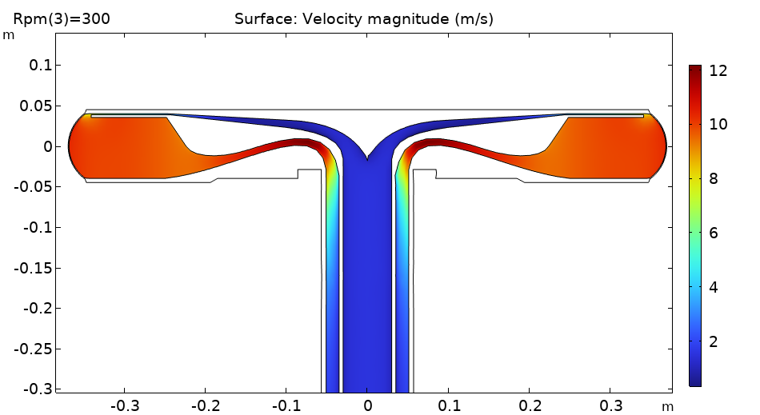
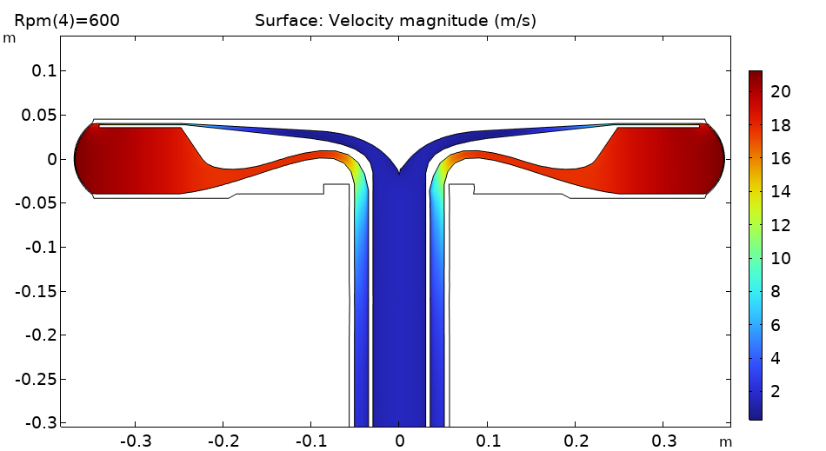
COMSOL results
Velocity on 2D plane

Slide 5
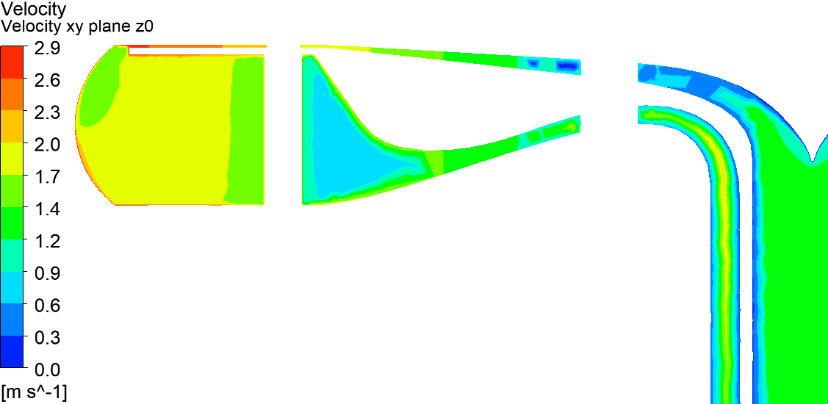
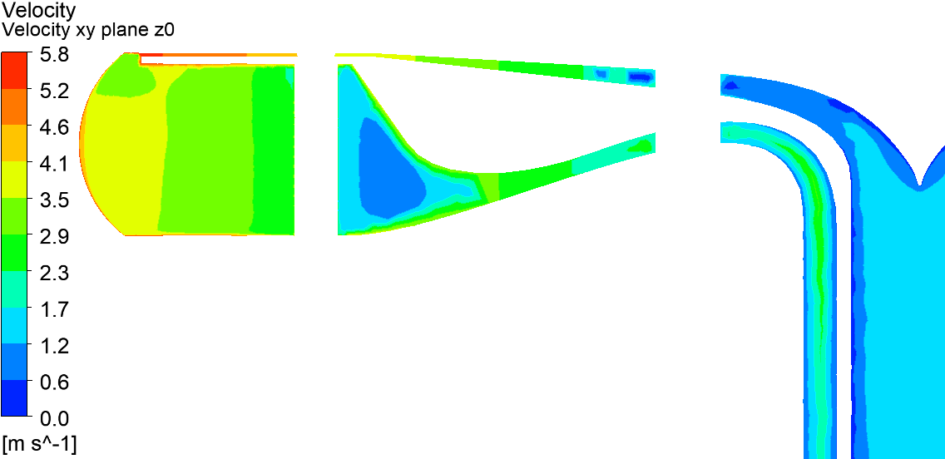
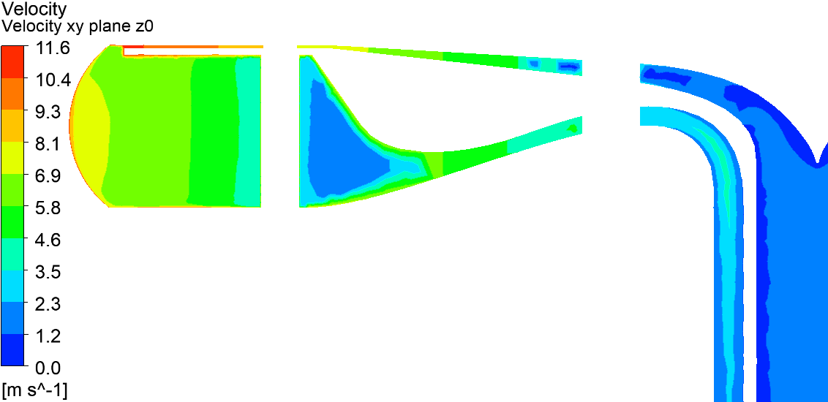
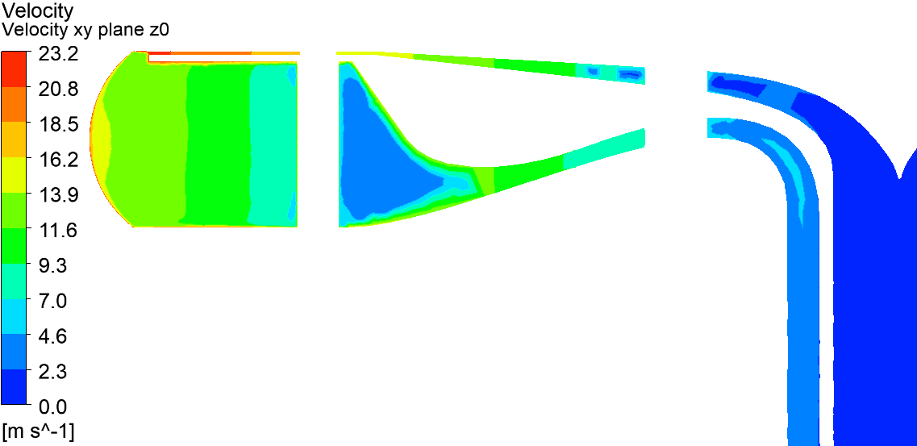
ANSYS results (with post)
FRIB-T40510-RC-008136-R001
75 rpm
150 rpm
300 rpm
600 rpm

Slide 6
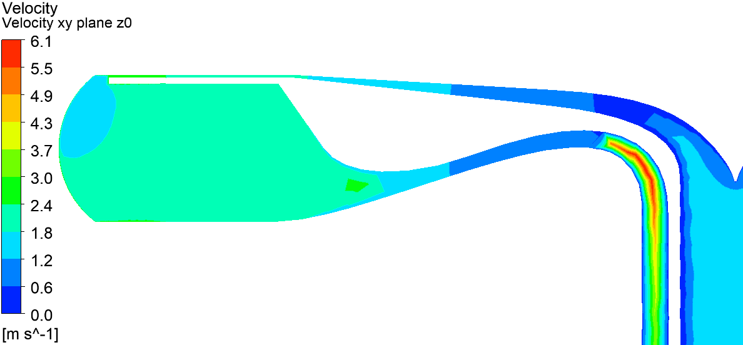
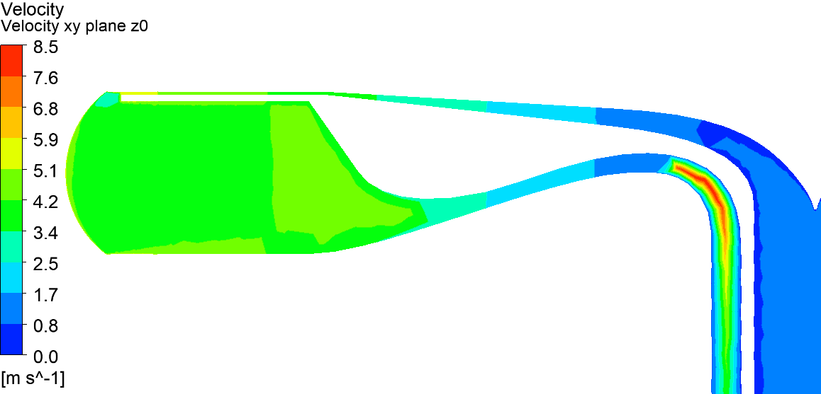
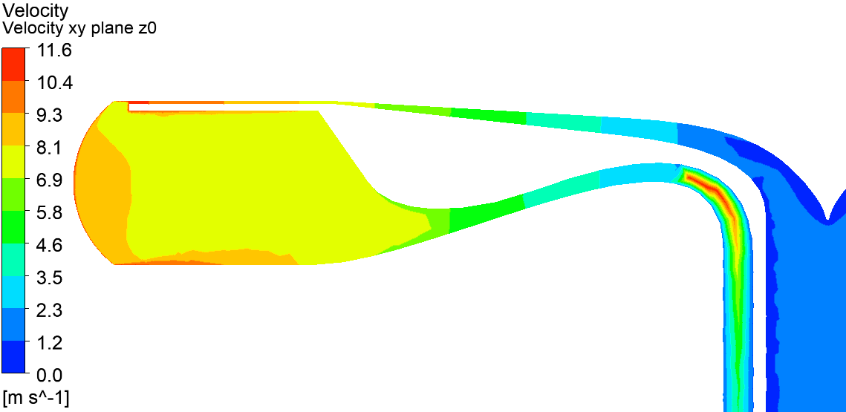
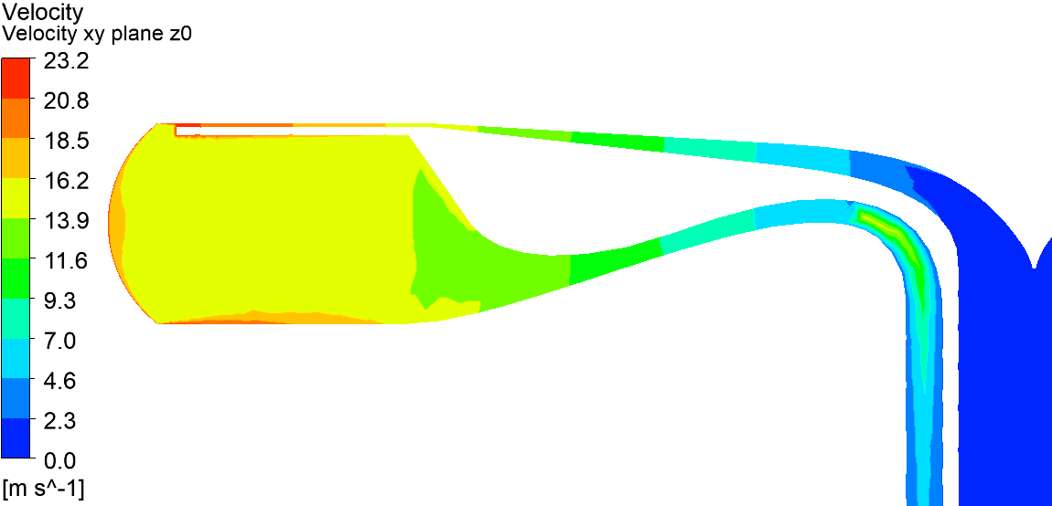
ANSYS results (without post)
FRIB-T40510-RC-008135-R001
75 rpm
150 rpm
300 rpm
600 rpm

Slide 7
Ongoing progress
Simulation (with post) will be performed next week.
(300 rpm case)

Slide 8
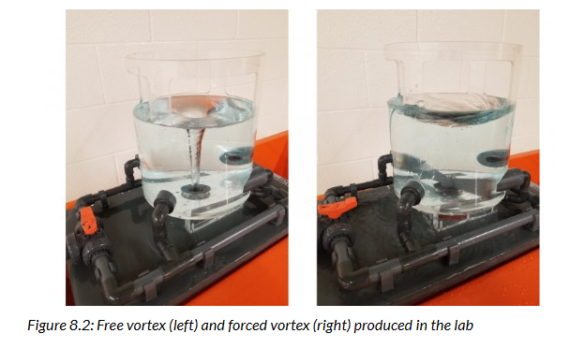
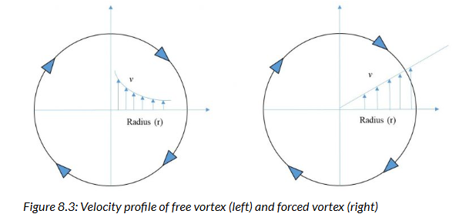
Ongoing progress
Free vortex vs forced vortex
https://uta.pressbooks.pub/appliedfluidmechanics/chapter/experiment-8/

Slide 9
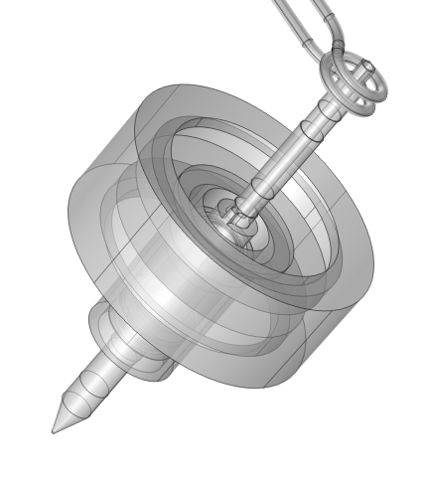
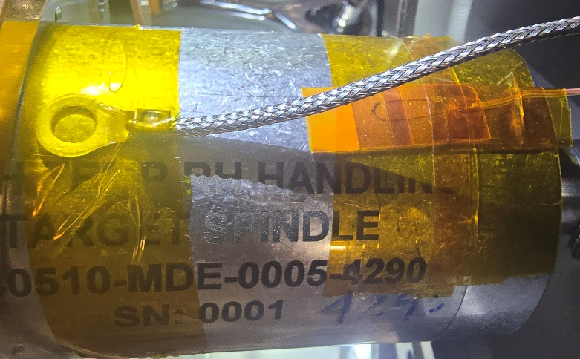
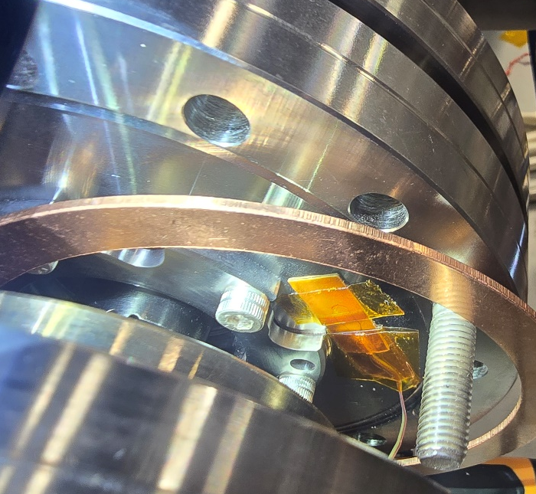
Experiment results
Rotating target system data (0905, 1000 rpm (start 7:35, end 18:00))
TC0 [C] | 47.4
TC1 [C] | 74.1
TC2 [C] | 66.4
TC3 [C] | 67.2
TC 2,3
TC1

Slide 10
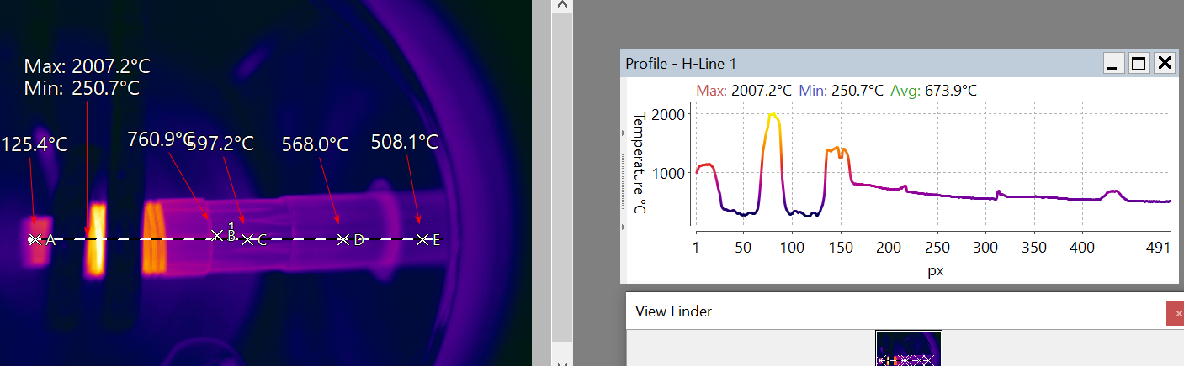
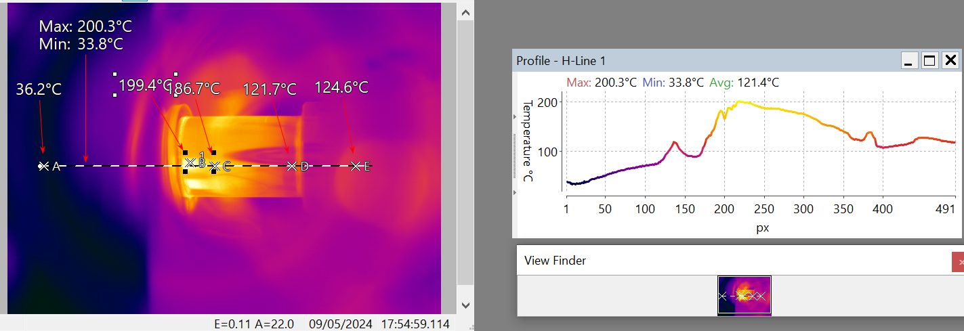
Experiment results

Slide 11
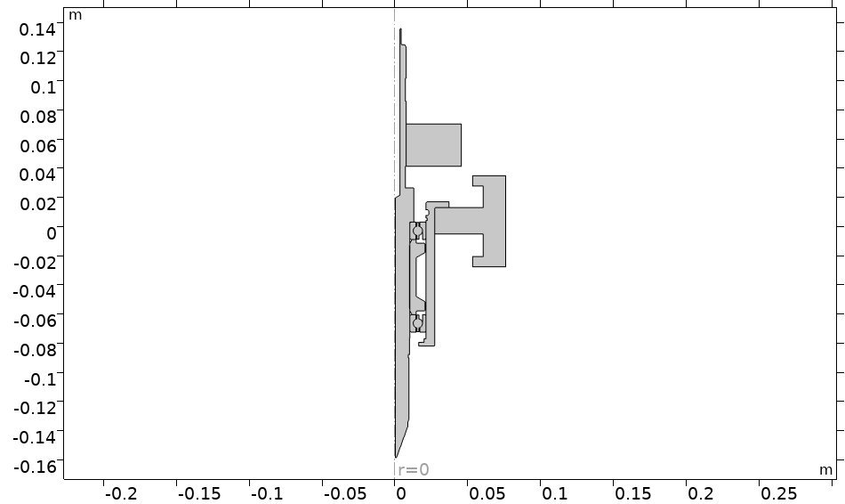
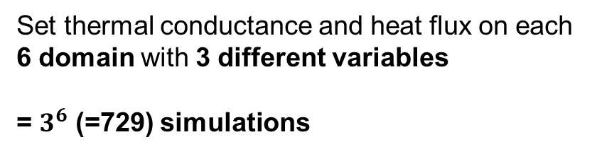
Simulation conditions
2D axis-symmetry simulation
1st
Matching Heat input + thermal conductance on weight
1st
2nd
2nd
Set thermal conductance and heat flux on each 6 domain with 3 different variables
= $3^{6}$ (=729) simulations

Slide 12
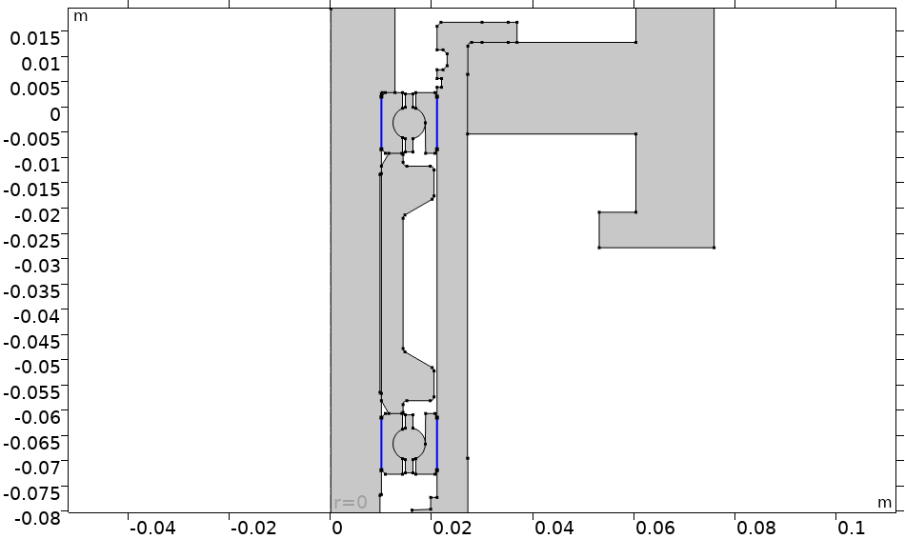
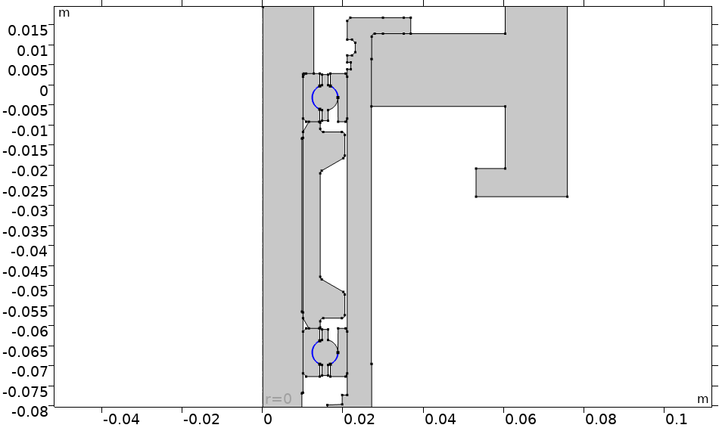
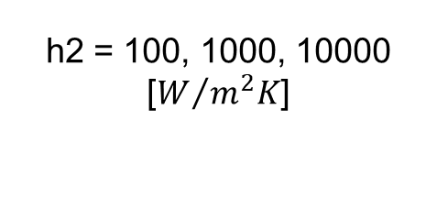
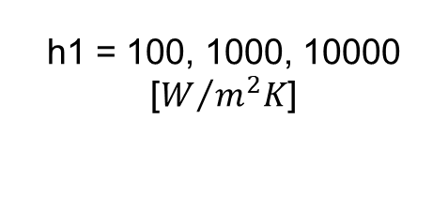
Simulation results
h1 = 100, 1000, 10000 [$W/{m^{2}K}$]
h2 = 100, 1000, 10000 [$W/{m^{2}K}$]

Slide 13
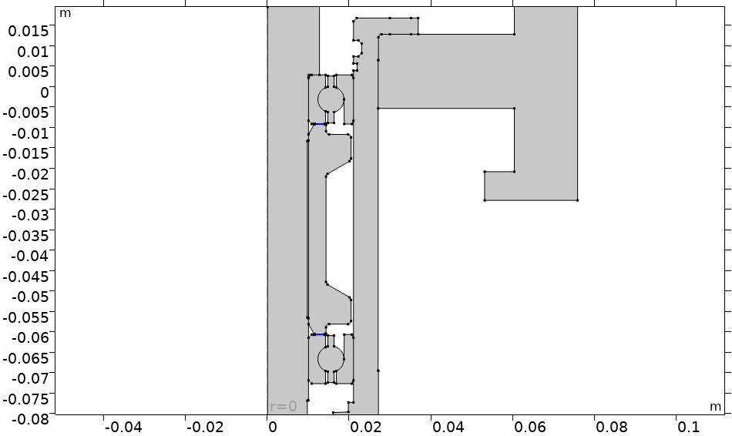
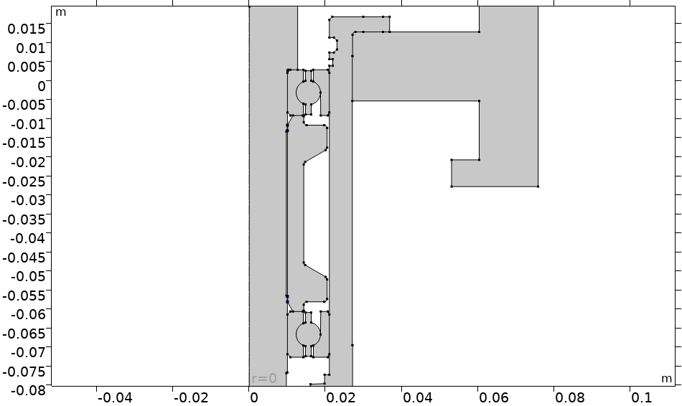
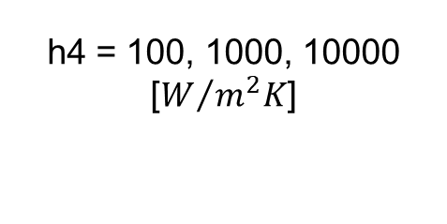
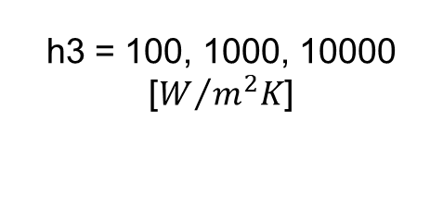
Simulation conditions
h3 = 100, 1000, 10000 [$W/{m^{2}K}$]
h4 = 100, 1000, 10000 [$W/{m^{2}K}$]

Slide 14
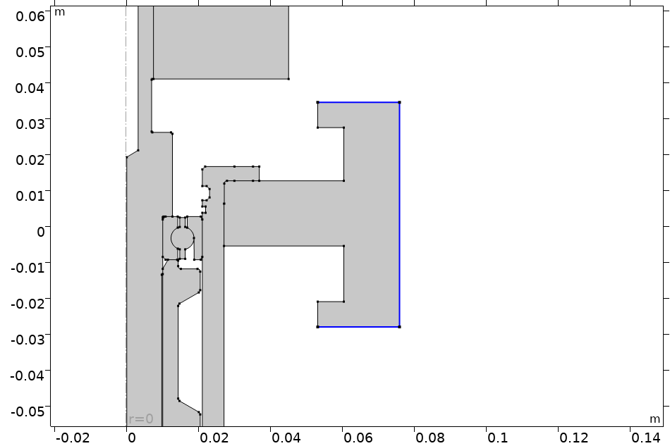
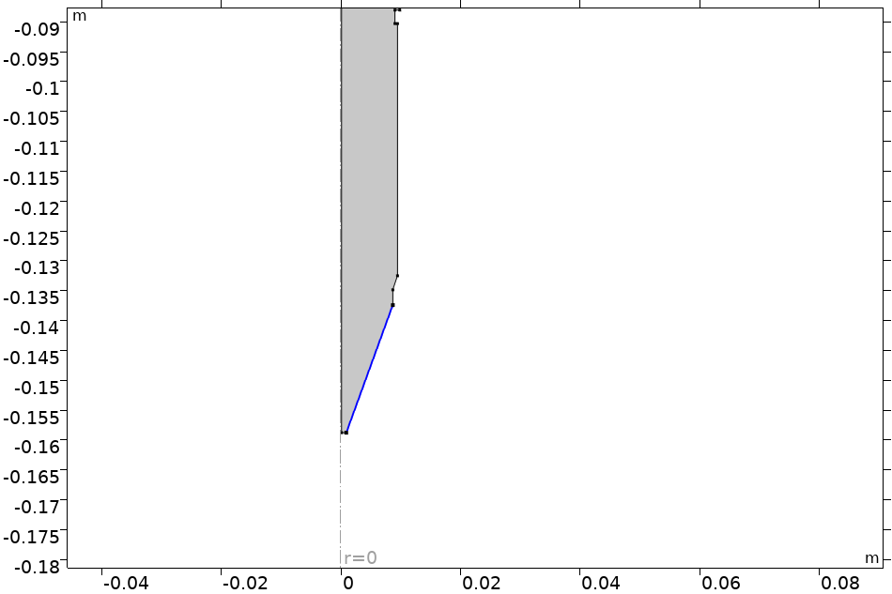
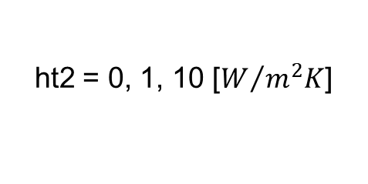
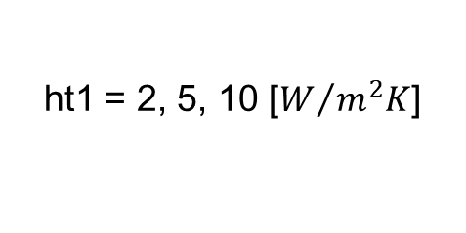
Simulation conditions
ht1 = 2, 5, 10 [$W/{m^{2}K}$]
ht2 = 0, 1, 10 [$W/{m^{2}K}$]

Slide 15
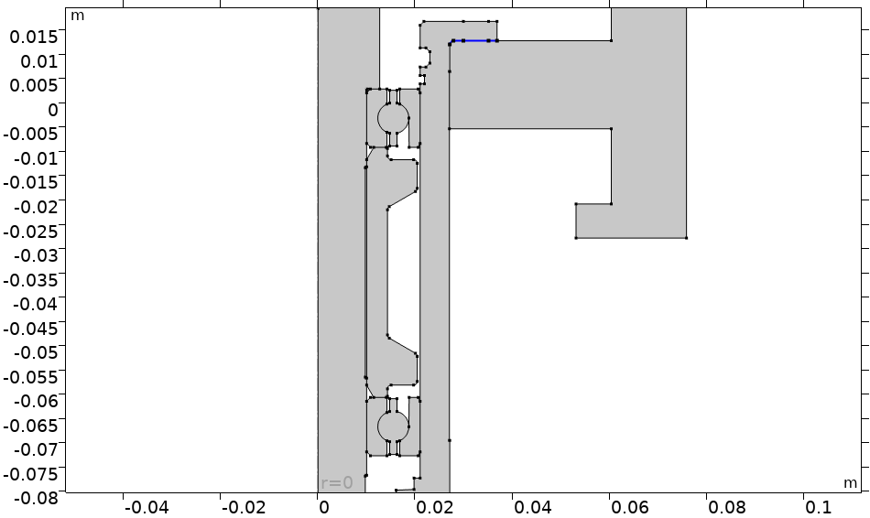
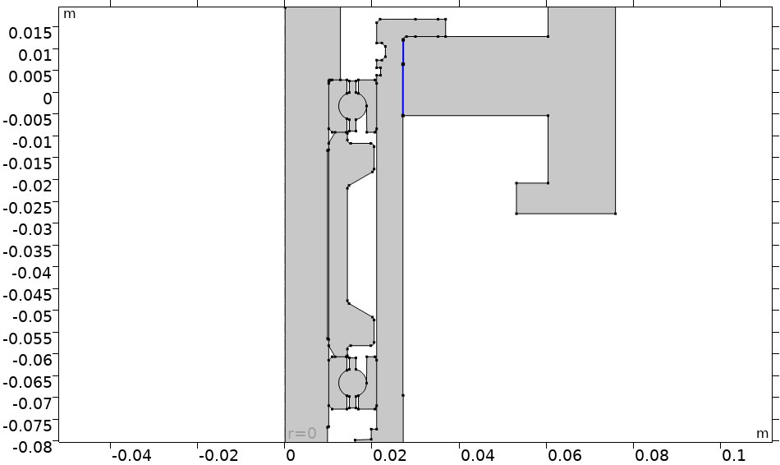
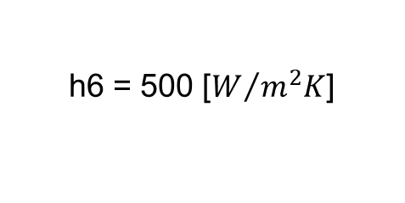
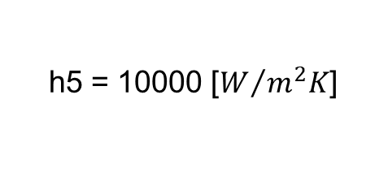
Simulation conditions
h5 = 10000 [$W/{m^{2}K}$]
h6 = 500 [$W/{m^{2}K}$]

Slide 16
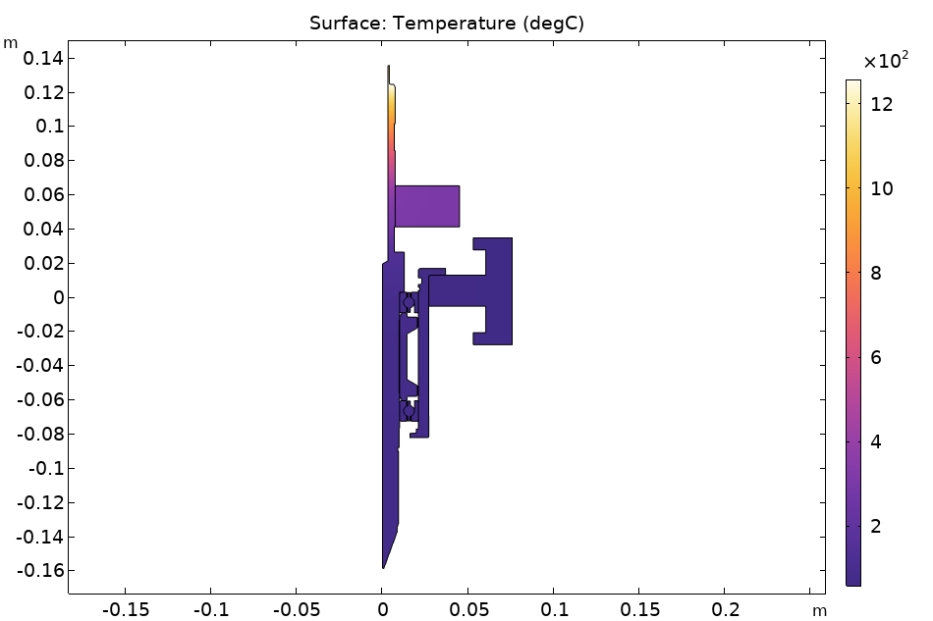
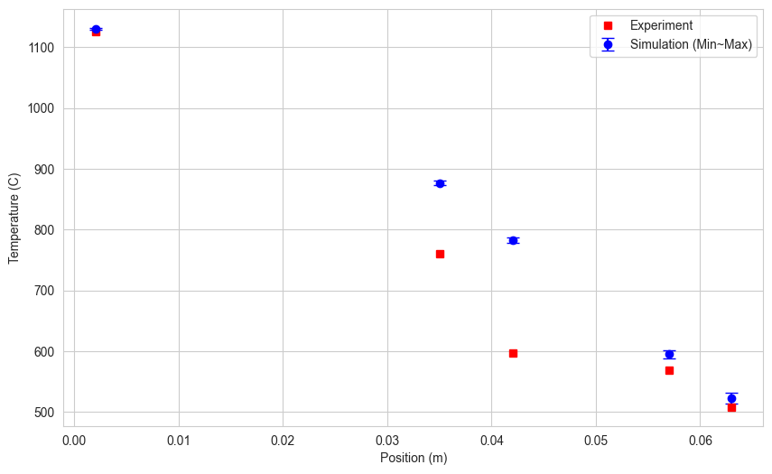
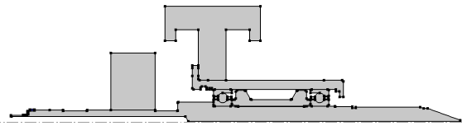
Simulation results
Position = 0

Slide 17
Simulation results
Experiment: 186.7 C
Simulation: 70 ~ 180 C
 | Experiment | Simulation
TC0 [C] | 47.4 | 48~95
TC1 [C] | 74.1 | 50~100
TC2 [C] | 66.4 | 55~105
TC3 [C] | 67.2 | 60~108
In every cases,
TC1 < TC2
TC0-TC1 < 5 C

Slide 18

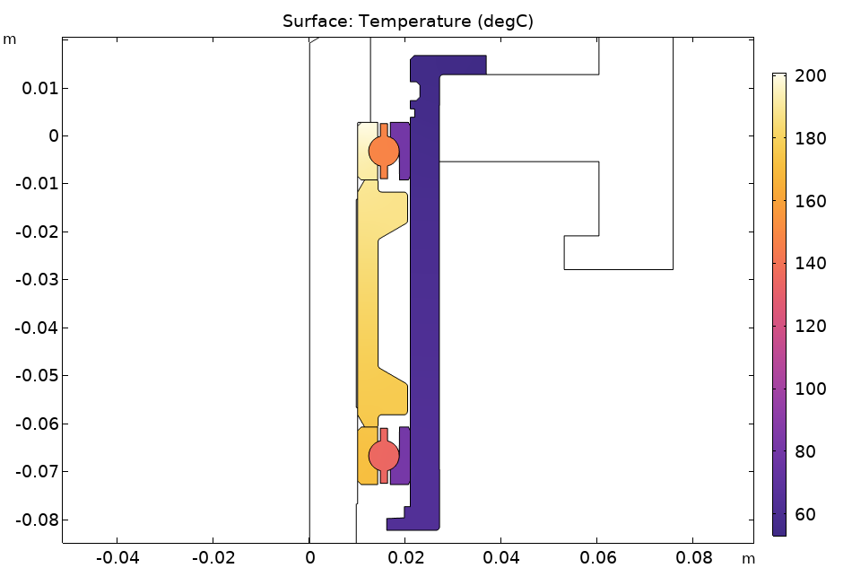
Best match cases
Best-match variables
 | Shaft upper parts |  |  |  |  | Shaft lower | TC0 | TC1 | TC2 | TC3
 | T1 | T2 | T3 | T4 | T5
Simulation | 1131.5 | 878.8 | 785.0 | 599.8 | 528.9 | 167.2 | 49.264 | 51.784 | 58.209 | 63.459
Experimental | 1125.4 | 760.9 | 597.2 | 568.0 | 508.1 | 186.7 | 47.4 | 74.1 | 66.4 | 67.2
Difference [%] | 0.5 | 13.4 | 23.9 | 5.3 | 3.9 | 11.7 | 3.8 | 43.1 | 14.1 | 5.9
h1 | h2 | h3 | h4 | ht1 | ht2
100 | 100 | 10000 | 1000 | 10 | 0
h3 & h4 affects only shaft lower temperature (<10 %)
Conclusion:
More detailed analysis would satisfying experimental results (h1,h2 < 100, ht1 > 10)
But, it still can not explain ‘TC1 < TC2’

